Slide 1
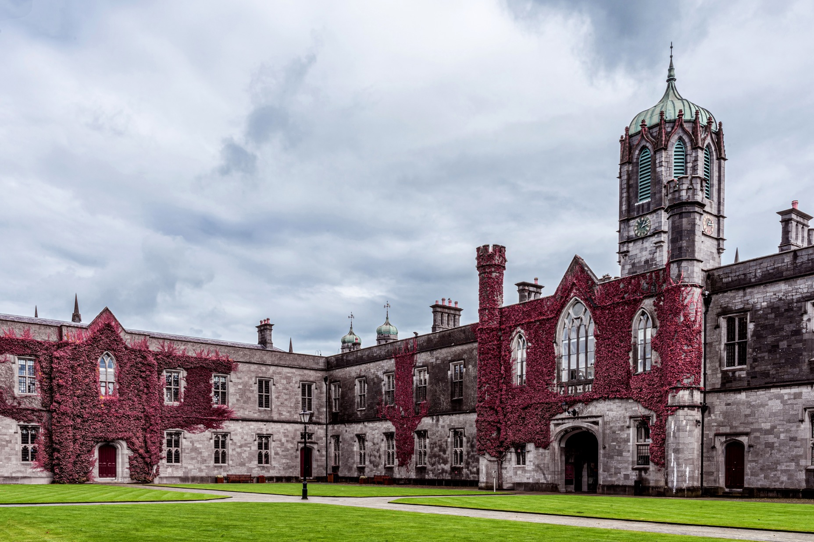
CT336/CT404 Graphics & Image Processing Sem 1 (Autumn) 2024-25, Dr. Nazre Batool 4th year B.Sc. (CS&I.T.). 2nd year M.Sc. (Software Development & Design) 1st year M.Sc. (Biomedical Engineering) Visiting students

Slide 2
Lecture 4: Image Filtering
Last Lecture:
Introduction to image processing
Point and geometric transformations
Spatial filtering (part 1 of 2)
2D Convolution
Smoothing filters
Today:
Image Filtering in Spatial Domain (part 2 of 2)
Differentiating filters: 1st order and 2nd order
Image Filtering in Frequency Domain
What is a frequency domain? (some Digital Signal Processing!)
How are images represented as (2D) frequencies? 2D Fourier Transform
Low-pass and high-pass filters

Slide 3
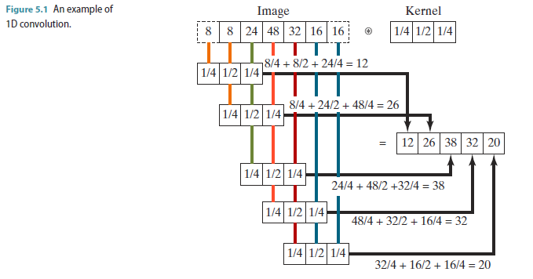
Spatial Filtering (2D-Convolution)
A fundamental local operation in image processing​
Used for a variety of tasks, including noise removal, blurring, sharpening, and edge detection. ​
Establish a moving window ('kernel') which contains an array of coefficients or weighting factors. ​
Move the kernel across the original image, so that it centres on each pixel in turn. Each coefficient in the kernel is multiplied by the value of the pixel below it, and the addition of each of these values determines the value of the pixel in the output image corresponding to the pixel in the centre of the kernel.​
The operation of convolution is denoted by
For symmetric kernels with real numbers and signals with real values (as is the case with images), convolution is the same as cross-correlation.
*
=
*

Slide 4
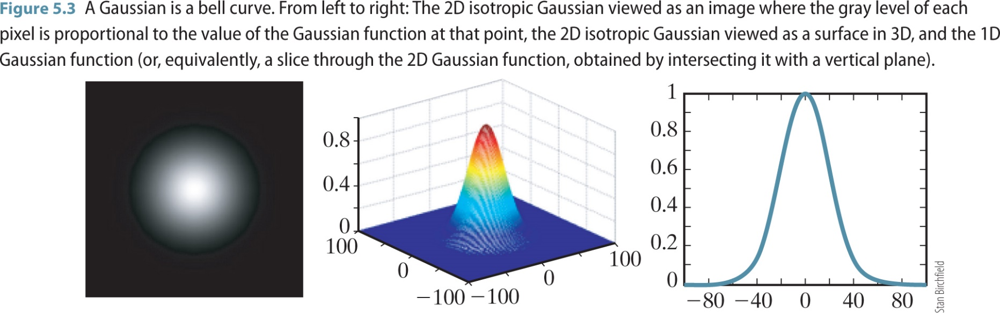
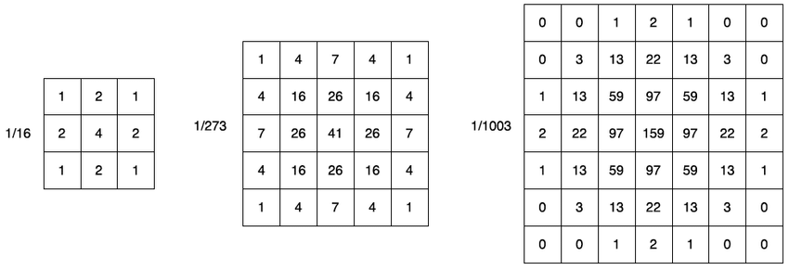
Gaussian Smoothing Kernel
Discrete Approximation of Isotropic Gaussian filter 3x3, 5x5, 7x7

Slide 5
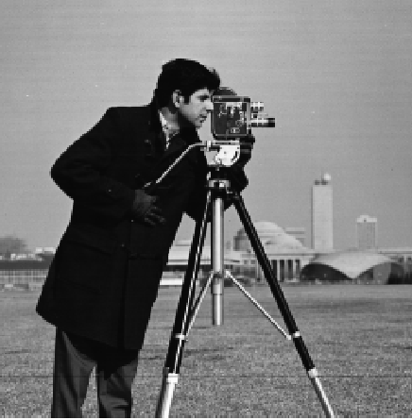
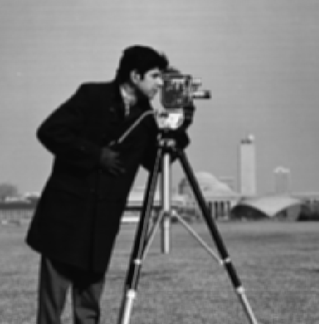

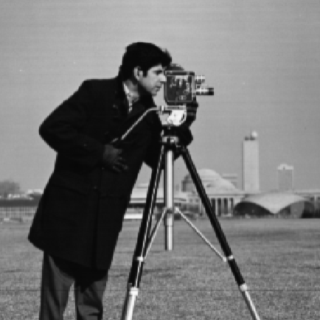

Image Filtering for Noise Reduction
Typically use ‘smoothing’ high-frequency noise without unduly damaging larger (low-frequency) objects of interest
Commonly used smoothing filters.
1. Blur - averages a pixel and its neighbours
2. Median - replaces a pixel with the median, rather than the mean, of the pixel and its neighbours
Gaussian - a filter that produces a smooth response (unlike blur/’box’ and median filtering) by weighting more towards the centre
Original
Box (Average) Filter 3x3
Gaussian filter: 3x3, sigma 0.5 7x7, sigma 0.5
7x7, sigma 1.5

Slide 6
Image Filtering
Why do we need to filter images? A typical “classical” computer vision pipeline has following steps:
1. Clean up/Pre-processing
reduce noise (smoothing kernels)
remove geometric/radiometric distortion
emphasise desired aspects of image e.g. edges, corners, blobs, etc. (differentiating kernels, feature detectors)
2. Segmentation (might not be needed in deep learning based approaches)
identify/extract objects of interest
sometimes the entire image is ‘of interest’ and the task is to separate it into non-overlapping regions
probably leverages domain-specific knowledge
3. Measurement (might not be needed in deep learning based approaches)
quantify appropriate measurements on segmented objects
4. Classification
assign segmented objects to classes
make decisions etc.

Slide 7
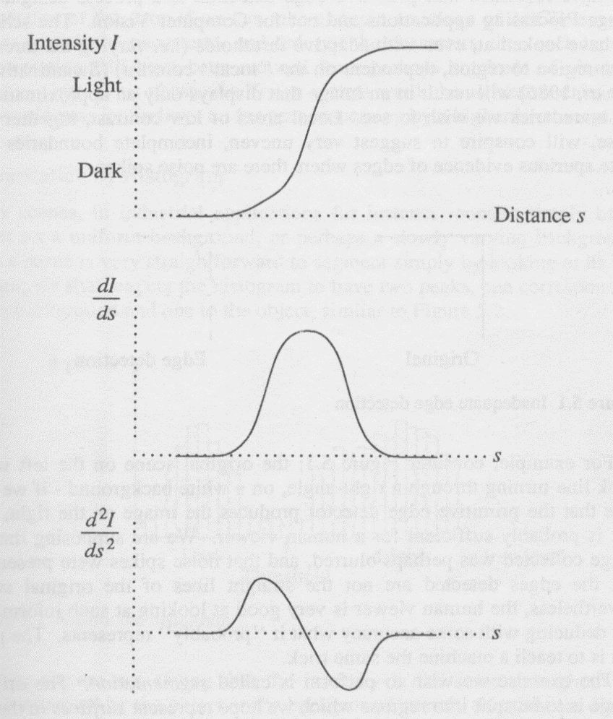
Edge Detector/Differentiating Filters as Mathematical Derivatives
Consider a horizontal slice across the image
Edge detection filters are essentially performing differentiation of grey level with respect to distance
i.e. ‘how different is a pixel to its neighbours’?
Some filters are akin to first derivatives, while others are akin to second derivatives

Slide 8
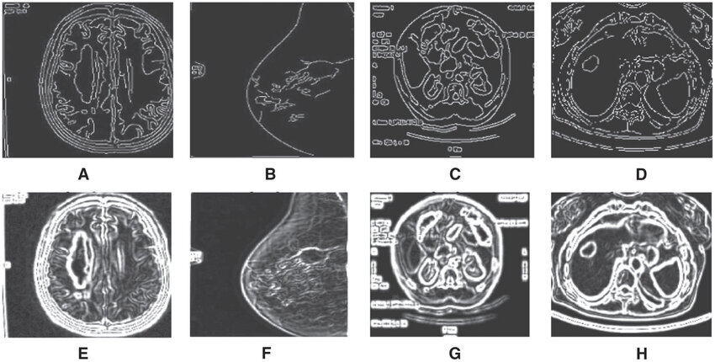
Image Filtering for Edge Detection
Differentiating kernels can represent first order or second order derivatives.
Differentiating kernels for edge detection can also be classified as gradient magnitude type or gradient direction type.
What is Edge Detection? (will cover more in a later lecture)
A common early step in image segmentation (often preceded by noise reduction)
Determines how different pixels are from their neighbours: abrupt changes in brightness are interpreted as the edges of objects
The aim is to provide evidence for the automatic delineation of objects in a scene, which are assumed to be characterised by their edges
Edge Detection in Medical Images (source [1])
[1] https://www.researchgate.net/publication/325750965_An_Overview_of_Segmentation_Algorithms_for_the_Analysis_of_Anomalies_on_Medical_Images

Slide 9
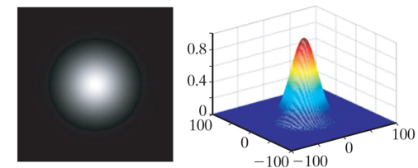
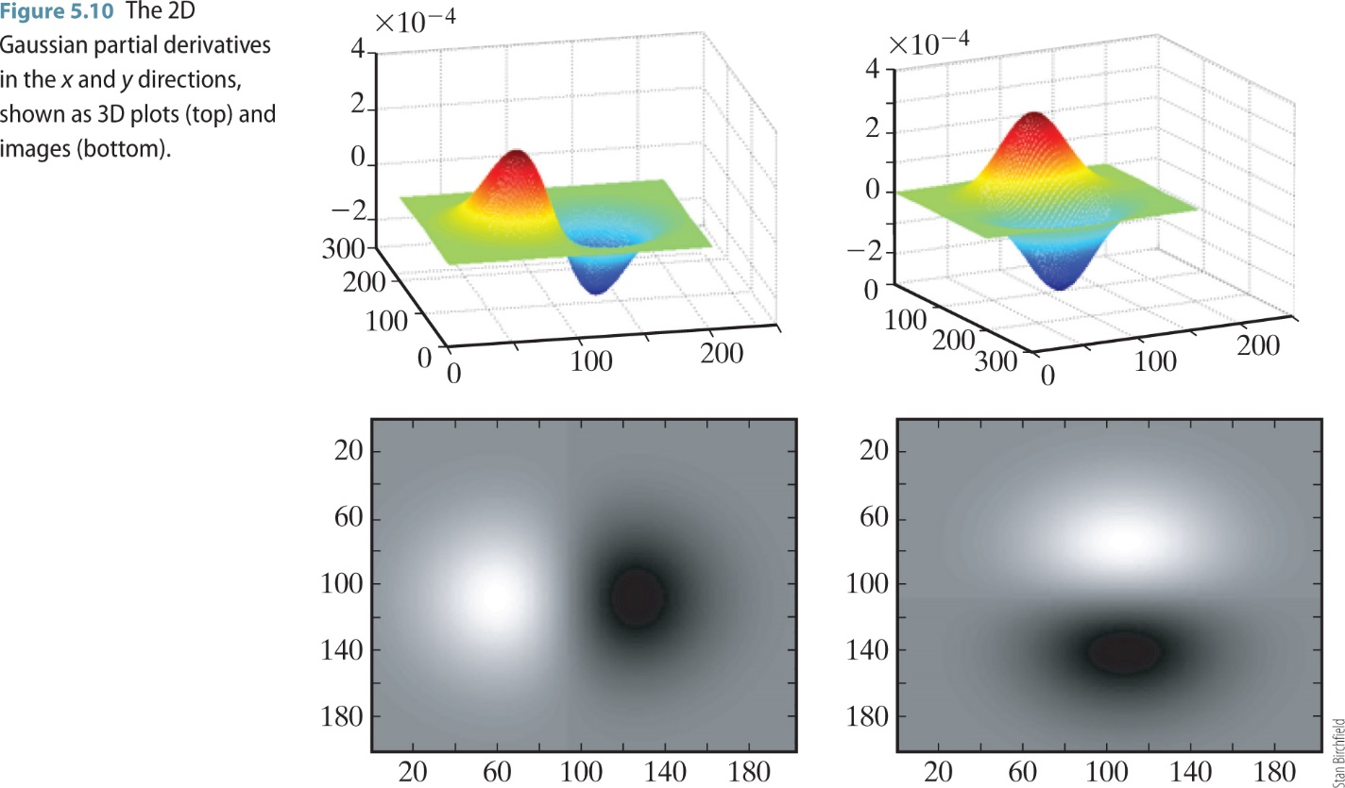
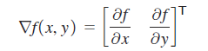
First order derivatives
General pipeline:
Smoothing (to reduce noise) -> Derivative (so as noise is not accentuated)
Most differentiating kernels are built combining these two operations
First order derivatives:
1D Gaussian derivative kernels
2D Gaussian derivative kernels: Image gradients
The Gaussian kernel

Slide 10
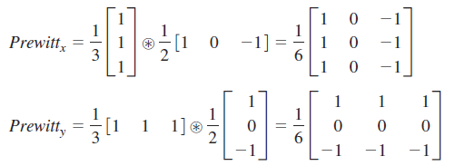
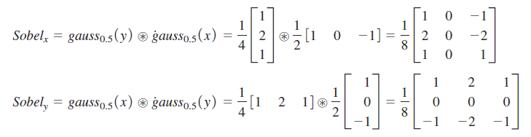
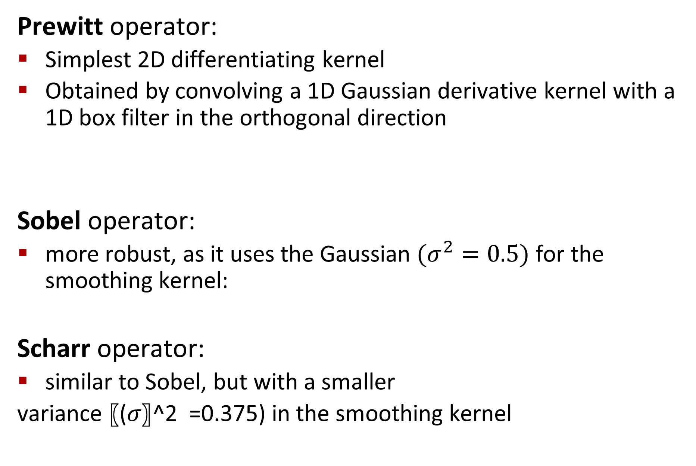
First order derivatives
Box (Smoothing)
1D Gaussian (Differentiating)
Prewitt operator:
Simplest 2D differentiating kernel
Obtained by convolving a 1D Gaussian derivative kernel with a 1D box filter in the orthogonal direction
Sobel operator:
more robust, as it uses the Gaussian $(σ^{2}=0.5)$ for the smoothing kernel:
Scharr operator:
similar to Sobel, but with a smaller
variance 〖(𝜎〗^2 =0.375) in the smoothing kernel
1D Gaussian (Smoothing)
1D Gaussian (Differentiating)

Slide 11
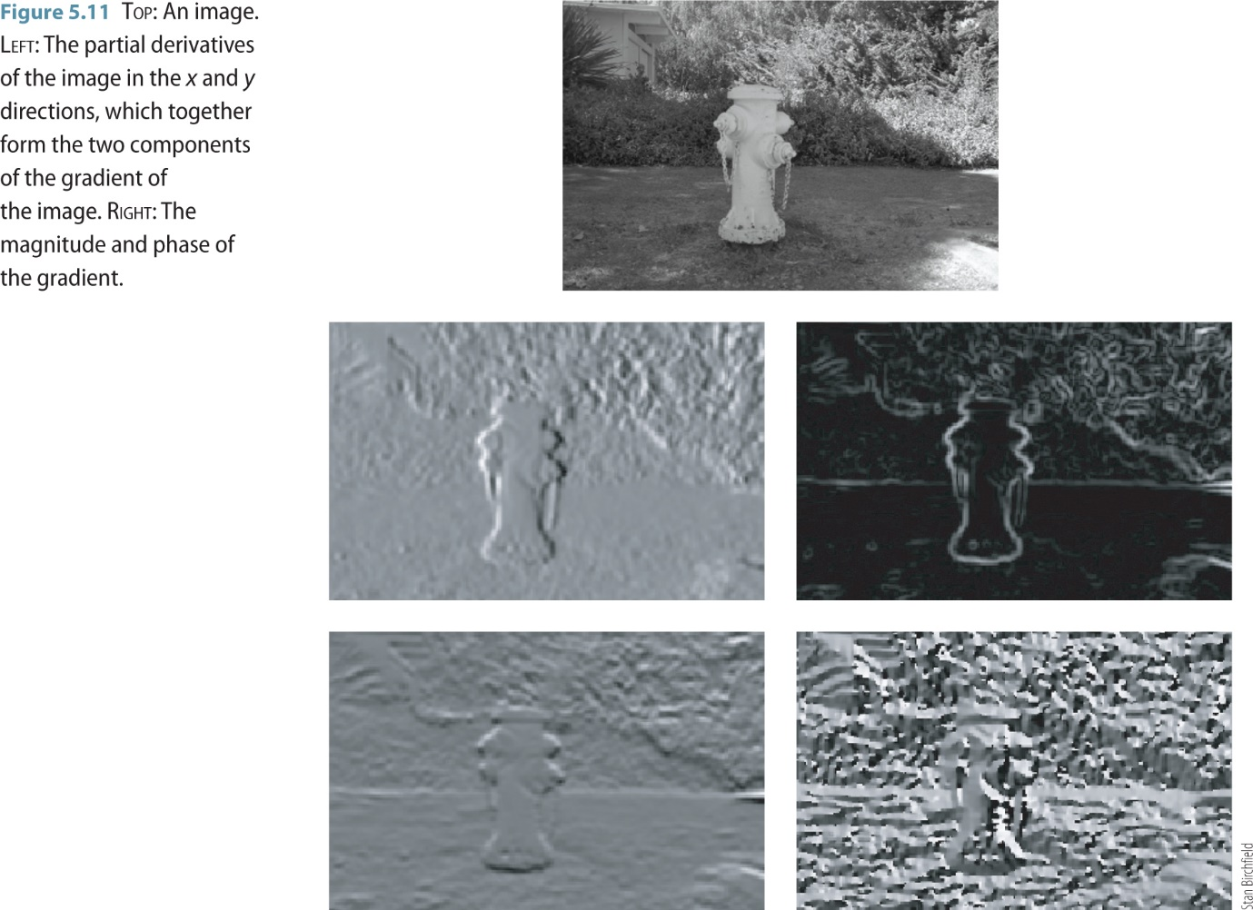
First order derivatives
Example:
Calculate ‘magnitude images’ of the directional image gradients.

Slide 12
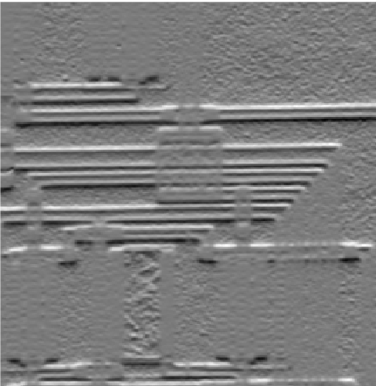
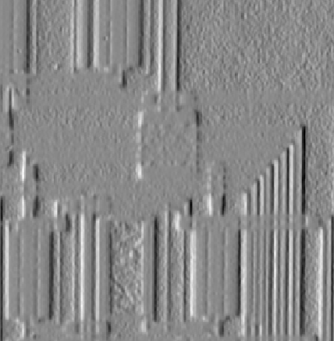

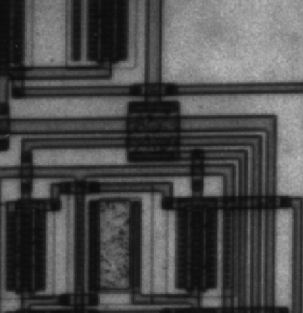
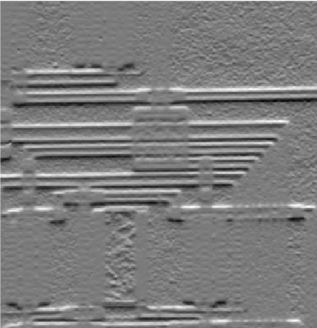
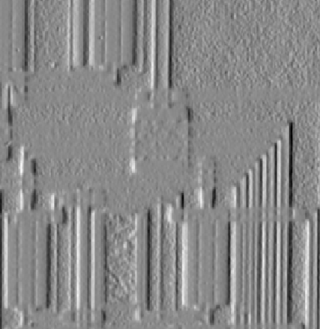

First order derivatives
Example:
Calculate edges by thresholding ‘magnitude images’ of the directional image gradients.
Prewitt Operator
Sobel Operator
Input Grayscale image
Vertical gradient Horizontal gradient Thresholded gradient magnitude

Slide 13
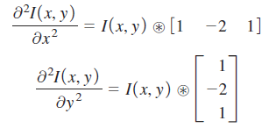
Second order derivatives
For a function (or image) of two variables, the second-derivative in the x and y directions can be obtained by convolving with the appropriately oriented second-derivative kernel
What makes this a 2nd order derivative?
This can be seen in 1D by convolving the function with the noncentralized difference operator, then convolving the result again with the same operator:

Slide 14
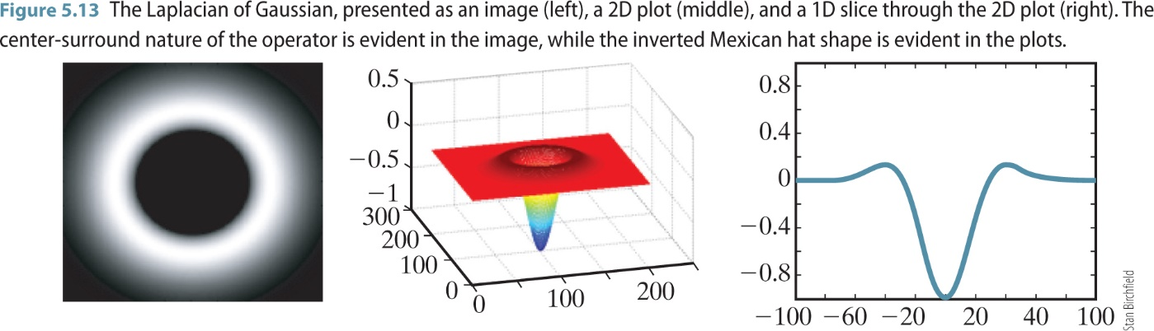
Second order derivatives
NOTE: These 2D derivatives are not isotropic or symmetric!
Is there any isotropic 2D derivative operators?

Slide 15
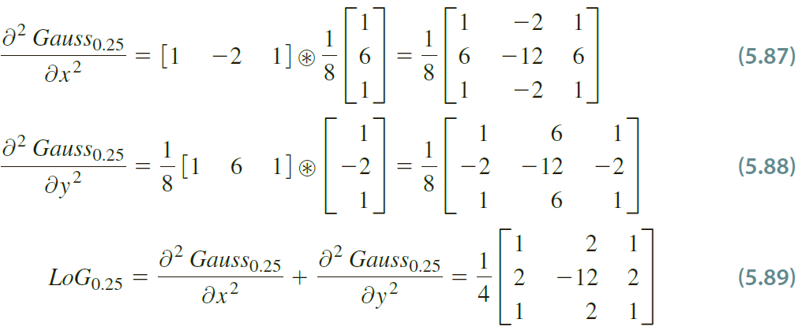
Second order derivatives
Laplacian of Gaussian (LoG) operator (isotropic, symmetric):
Laplacian alone is defined as sum 2nd derivatives along the two axes:
Laplacian, being a 2nd derivative, is highly sensitive to noise, therefore, preceded by Gaussian smoothing. ​
Remember? Most differentiating kernels are built combining two operations of smoothing and derivatives.
LoG is built by taking 2nd derivative of Gaussian
1D Gaussian (Smoothing)
1D Laplacian/2nd derivative (Differentiating)

Slide 16
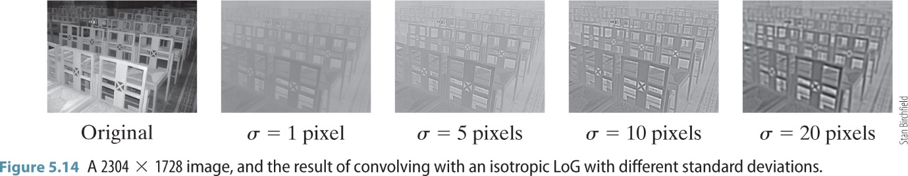
Second order derivatives
Laplacian of Gaussian (LoG) operator:
Due to its smoothing function, and to the fact that it responds to both increasing and decreasing image intensity, the LoG produces edge maps with multiple responses to each 'true' edge
characterised by multiple-pixel wide, inexact edges. ​

Slide 17
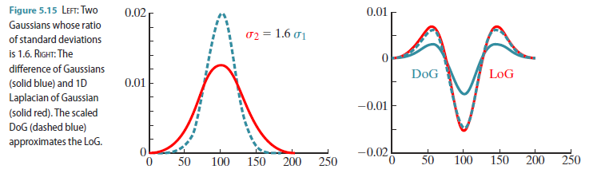
Second order derivatives
Difference of Gaussian (DoG) operator
Very similar to LoG

Slide 18
Lecture 4: Image Filtering
Last Lecture:
Introduction to image processing
Point and geometric transformations
Spatial filtering (part 1 of 2)
2D Convolution
Smoothing filters
Today:
Image Filtering in Spatial Domain (part 2 of 2)
Differentiating filters: 1st order and 2nd order
Image Filtering in Frequency Domain
What is a frequency domain? (some Digital Signal Processing!)
How are images represented as (2D) frequencies? 2D Fourier Transform
Low-pass and high-pass filters

Slide 19
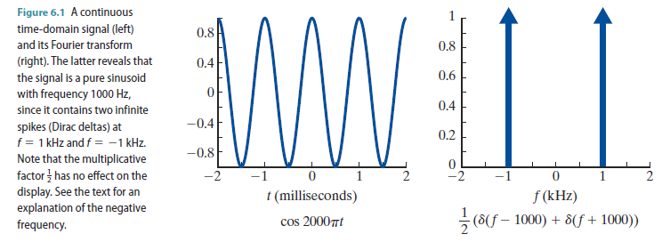
Image Filtering in Frequency Domain
What is a frequency domain?
Any signal, discrete or continuous, periodic or non-periodic, can be represented as a sum of sinusoidal waves of different frequencies and phases which constitute the frequency domain representation of that signal.

Slide 20
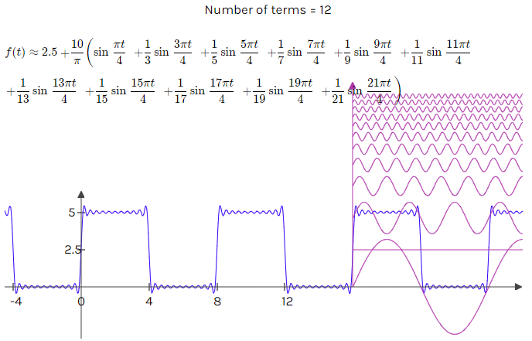
Image Filtering in Frequency Domain
What is a frequency domain?
Let us build a signal from a combination of sinusoidal waveforms.
Image reproduced from and interactive online tool (https://www.intmath.com/fourier-series/fourier-graph-applet.php)

Slide 21
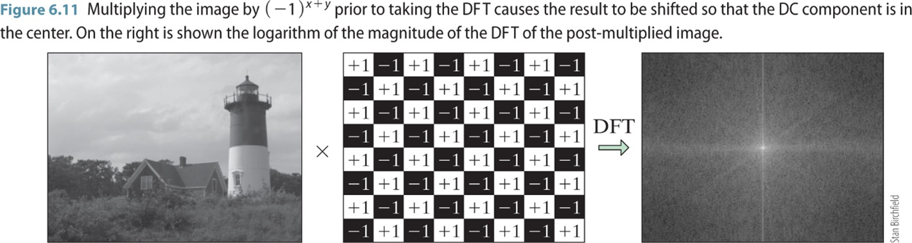
Image Filtering in Frequency Domain
Images (2D discrete signals) in the frequency domain
How do we obtain a frequency domain representation of an image? Fourier Analysis
Fourier Transform: Fourier analysis of discrete time signals which are of finite duration (image grid) and assumed periodic. Both signals and frequencies are discrete and finite.

Slide 22
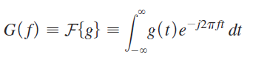
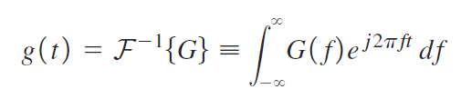
Fourier Transform
Forward Fourier transform G(f): the integration of the signal after first multiplying by a certain complex exponential:
If t is measured in seconds, then f is measured in inverse seconds, also known as hertz.
Inverse Fourier transform: defined in exactly the same way as the forward Fourier transform except for the sign in the exponent, and the fact that the integral is computed over frequency rather than over time:

Slide 23
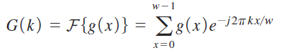
Discrete Fourier Transform
Discrete Fourier transform:
Let g(x) be a 1D discrete signal with w samples. The DFT of g is defined as the summation of the signal after multiplying by a certain complex exponential, where both x and k are discrete integers.
All modern implementations of the DFT use some variation of the FFT (Fast Fourier Transform) algorithm.
Discrete
Continuous
Discrete Fourier Transform
Fourier Transform

Slide 24
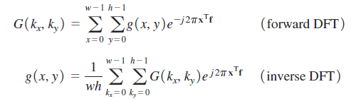
Discrete Fourier Transform
The 2D Discrete Fourier transform is a natural extension of the 1D case:
Replace the single frequency k with two frequencies in the two directions, k_{x} and k_{y}, so that kx/w becomes k_{x}x/w + k_{y}y/h.
Fun Fact: Where do you use this in your daily life?

Slide 25
Frequency Domain Filtering
Convolution in spatial domain is equivalent to multiplication in the frequency domain.
To convolve two signals, take their Fourier Transforms, multiply and take the inverse Fourier Transform to get the result.
Efficiency: Since multiplication is less expensive than convolution, this trick saves a lot of computational power when convolution kernels are big. (Why is this important even in the current age of almost limitless computation power?)
Filtering is used primarily for two applications:
Restoration: the goal is to remove the effects of noise that has degraded the image quality from its original condition.
Enhancement: involves accentuating or sharpening features to make the image more useful, going beyond simply a pure, noise-free image.

Slide 26
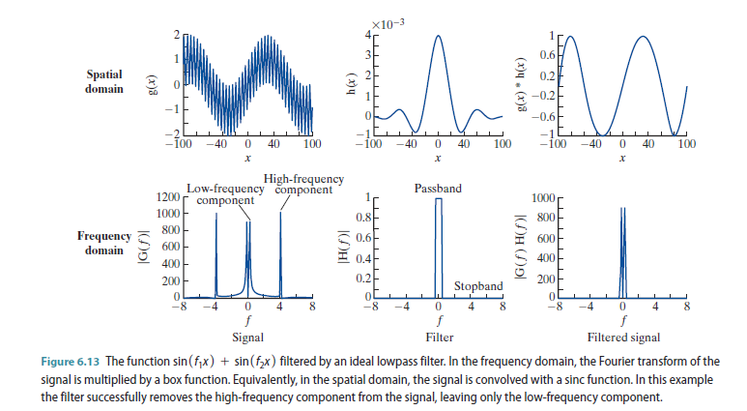
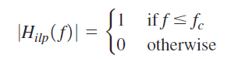
Frequency Domain Filtering
A Low-pass Filter allows low frequencies to pass through while attenuating high frequencies.
The ideal lowpass filter, also known as the box filter, perfectly passes all frequencies below a certain cutoff, while perfectly attenuating all frequencies above the cutoff.
But is a box filter really an IDEAL filter?

Slide 27
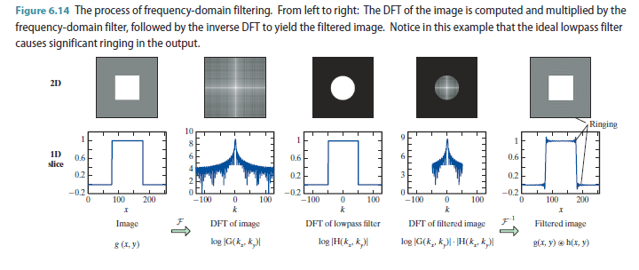
Frequency Domain Filtering
Filtering higher frequencies can result in image artefacts.

Slide 28
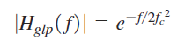
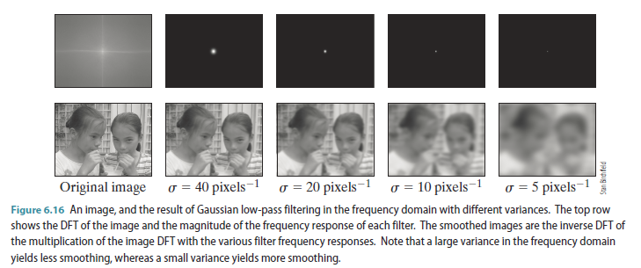
Frequency Domain Filtering
Gaussian Low-pass Filtering

Slide 29
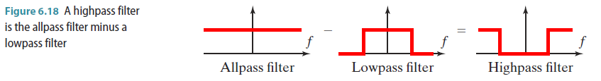
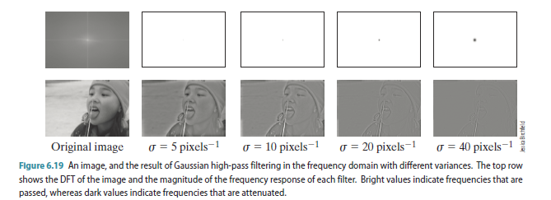
Frequency Domain Filtering
High-pass filters: obtained via negating an allpass filter with the magnitude of a lowpass filter.

Slide 30
Next Time
Binary image processing (image morphology)

Slide 31
Thank you

